Slide 1

IER Employment Law Update
Can gender pay gap information lead to fair pay?
November 2016

Slide 2
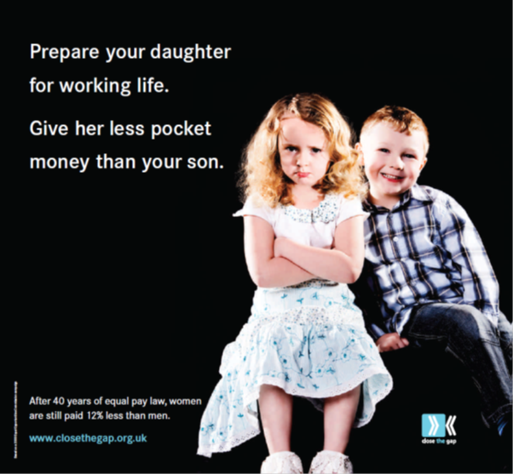
Gender pay gap information

Slide 3
What is the Gender Pay Gap?
The percentage difference in men and women’s pay:
Median | Mean
9.4% full time employees | 13.9% full time employees
18.1% all employees | 17.3% all employees

Slide 4
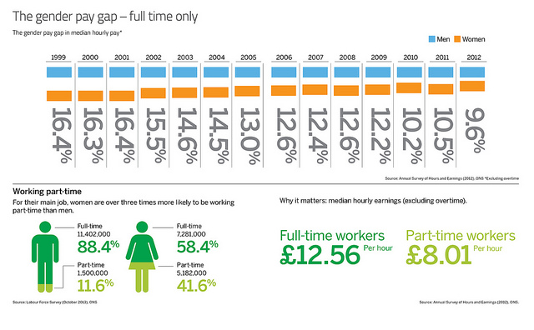
What is the Gender Pay Gap? - 2

Slide 5
So why is there a gender pay gap?
ONS Survey:
22% due to different industry and occupations in which woman work
21% due to the difference in time spent in full time work
16% due to the negative effect on wages having previously worked part time or having taken time out of the labour market to look after family
5% due to formal educational levels
36% could not be explained!

Slide 6
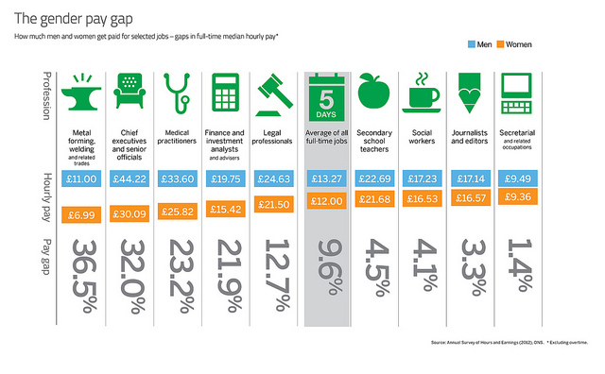
The Gender Pay Gap in various occupations

Slide 7
So what are the Government proposals?
The Equality Act 2010 (Gender Pay Gap Information (Regulations 2016) provide that private and voluntary employers with 250 + employees will be required to publish;
The mean and median gender pay gap;
The difference in bonus payments between men and women over a 12 month period;
The proportion of women and men employees in each quartile of the pay distribution;
A statement confirming that the information is accurate.
The information is to be published on the employers website and downloaded onto a Government website together

Slide 8
What the Regulations don’t do?
Don’t help identify the main causes of the gap pay;
Don’t explain the gender pay gap;
Don’t require employers to share the information with employees or trade unions;
Don’t require companies to develop a plan to reduce or remove gender pay gaps;
Don’t apply to 99% of private sector companies;
Don’t include any sanction or remedy or no compliance.

Slide 9
The Equality Act 2010 (Statutory
Duties) (Scotland)
The Equality Act 2010 (Statutory Duties) (Scotland) Regulations 2011 provide that a public authority with 20 or more employees must publish:
The percentage difference between men’s average hourly pay and women’s average hourly pay (overtime excluded).
An equal pay statement specifying the policy on equal pay among its employees between men and women.
Occupational segregation amongst its employees between men and women.

Slide 10
So what can Unions do?
Be the enforcers by:-
Include gender pay gap reporting as part of negotiating agenda for pay;
Use the provisions under Section 181 TULR(C)A 1992;
  “an employer who recognises an independent trade union shall for the purposes of all stages of collective bargaining… disclose to representatives of the union on request information… without which the trade union representatives would be to a material extent impeded in carrying on collective bargaining… and which it would be, in accordance with good industrial relations practice that he should disclose…”

